Slide 1
SLIDE 1 Title: Business Sales Performance Analytics
Subtitle: Data Science & Analytics Internship – Future Interns
Submitted by:
Vanukuri.Dhathri
Task 1
Date:
13 May 2026

Slide 2
SLIDE 2 Objective
Content:
The objective of this project is to analyze business sales data to identify revenue trends, top-selling products, high-performing regions, and business insights using Python and data visualization techniques.

Slide 3
SLIDE 3 Dataset Information
Dataset Name: Superstore Sales Dataset
Number of Rows: 9800+
Number of Columns: 18
Important Columns:
• Order Date
• Region
• Category
• Product Name
• Sales
• Profit
• Quantity

Slide 4
SLIDE 4 Tools & Technologies Used
Content:
• Python
• Pandas
• Matplotlib
• Jupyter Notebook
• VS Code

Slide 5
SLIDE 5 Data Cleaning Process
Content:
• Removed missing values
• Checked duplicate records
• Verified column names
• Converted date columns

Slide 6
SLIDE 6 Region-wise Sales Analysis
Add:
Bar chart screenshot
Region sales table
Write Insights:
• West region generated highest sales
• South region showed lower sales performance

Slide 7
SLIDE 7 Top Selling Products
Add:
Product chart screenshot
Insights:
• Technology products contributed more revenue
• Some products had consistently high sales

Slide 8
SLIDE 8 Monthly Revenue Trend
Add:
Line graph screenshot
Insights:
• Sales increased during festive months
• Revenue trend showed seasonal growth

Slide 9
SLIDE 9 Recommendations
Content:
• Focus marketing on low-performing regions
• Increase stock for high-selling products
• Improve promotional strategies
• Analyze customer preferences regularly

Slide 10
SLIDE 10 Conclusion
Content:
This analysis helped identify sales trends, profitable regions, and top-performing products. The project improved business analytics and data visualization skills.

Slide 11
SLIDE 11 GitHub Repository
GitHub Repository Link :
https://github.com/dhathri-252/FUTURE_DS_01

Slide 12
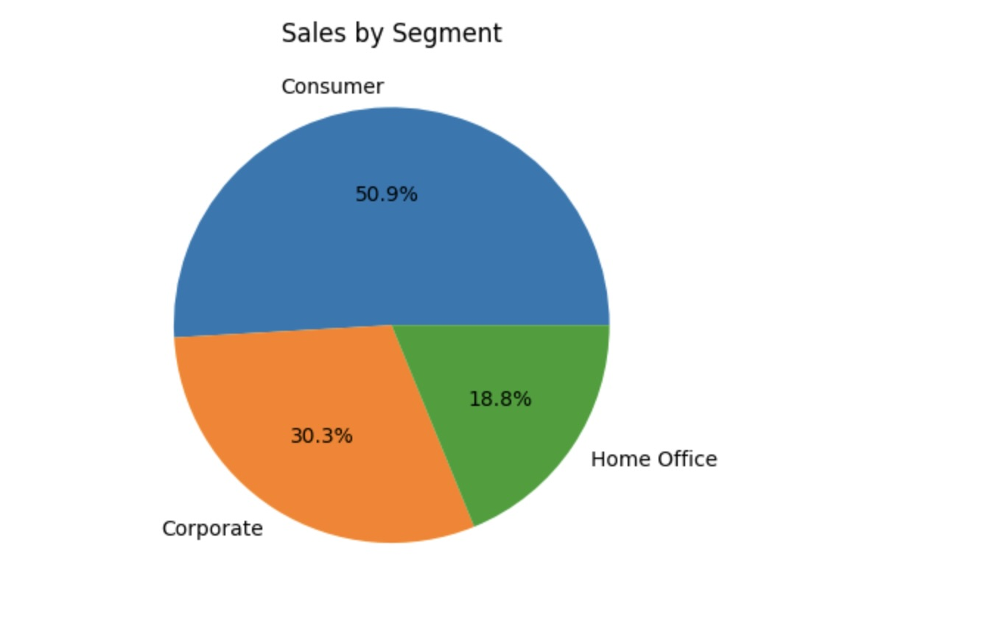
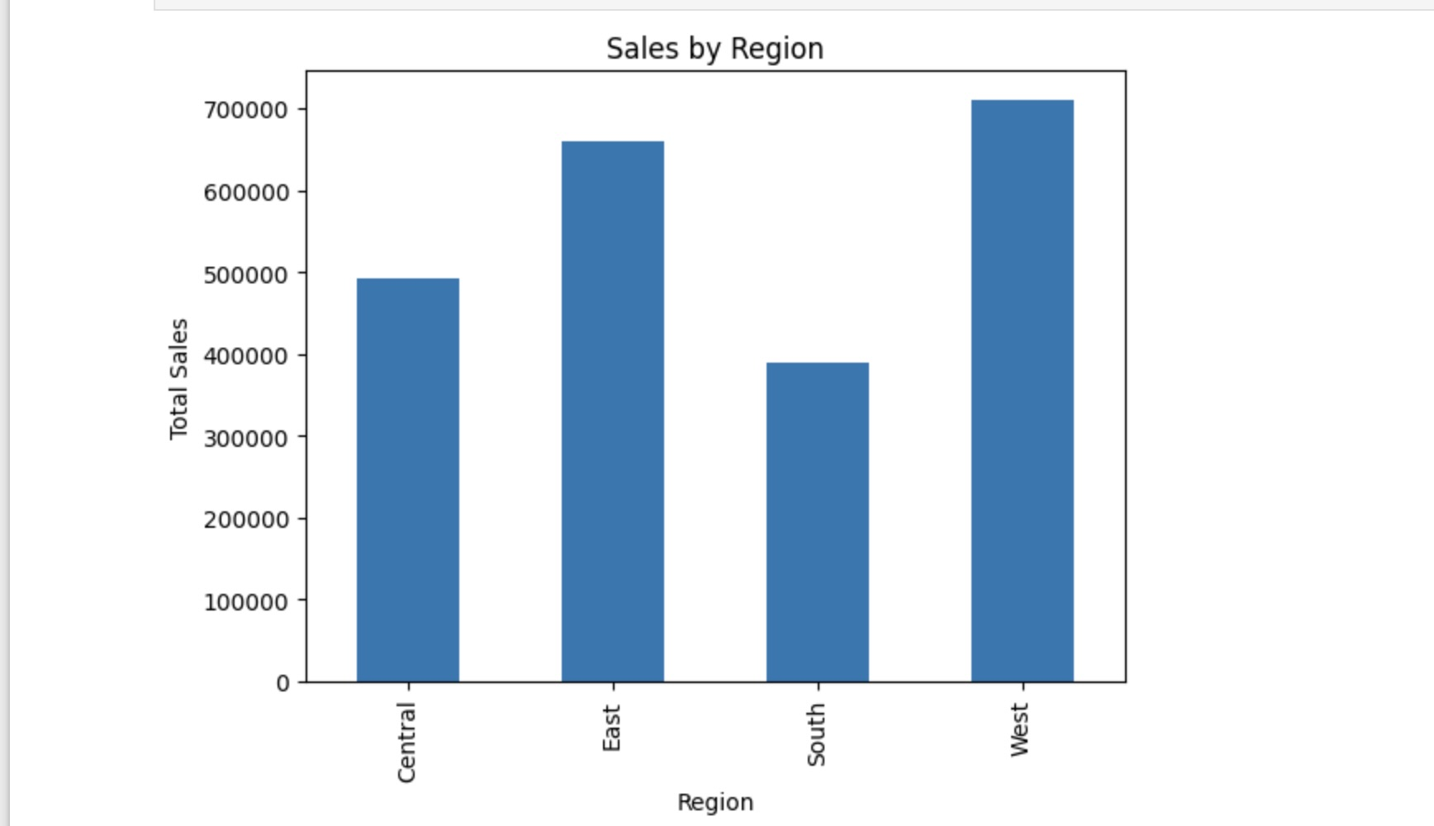
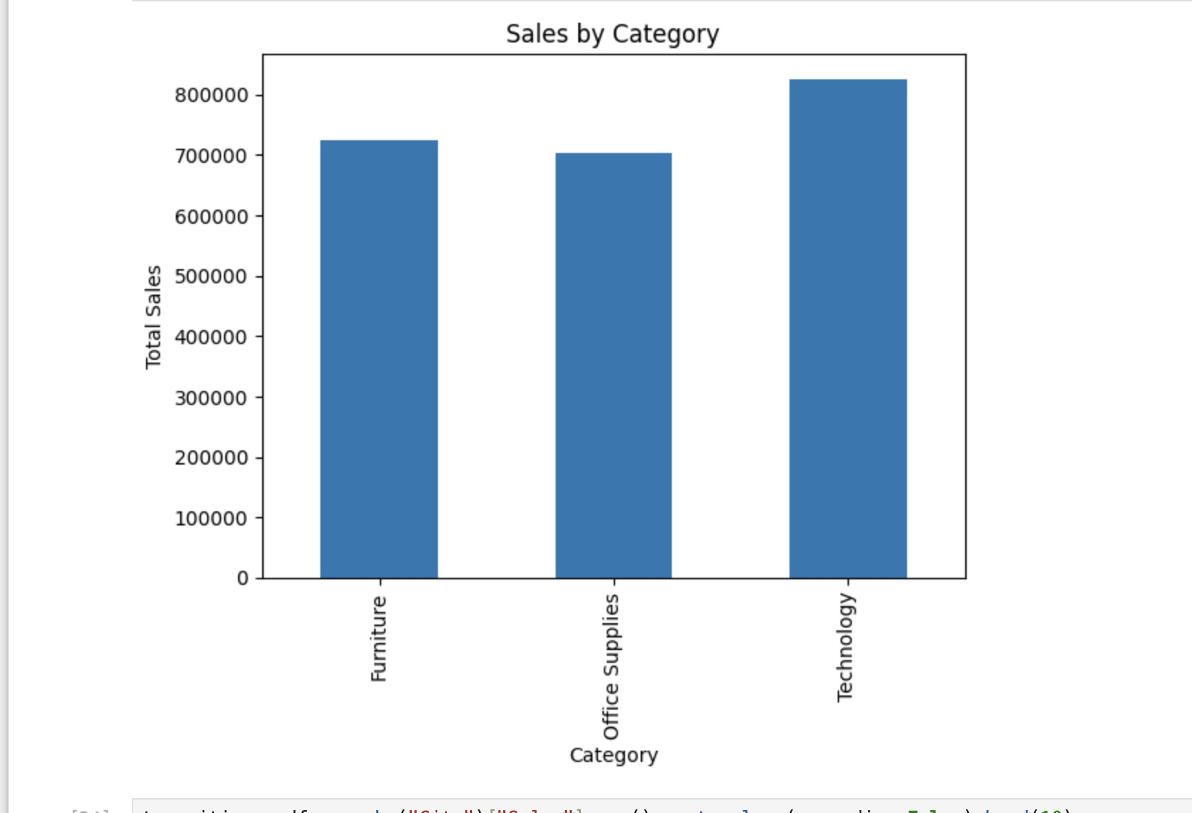
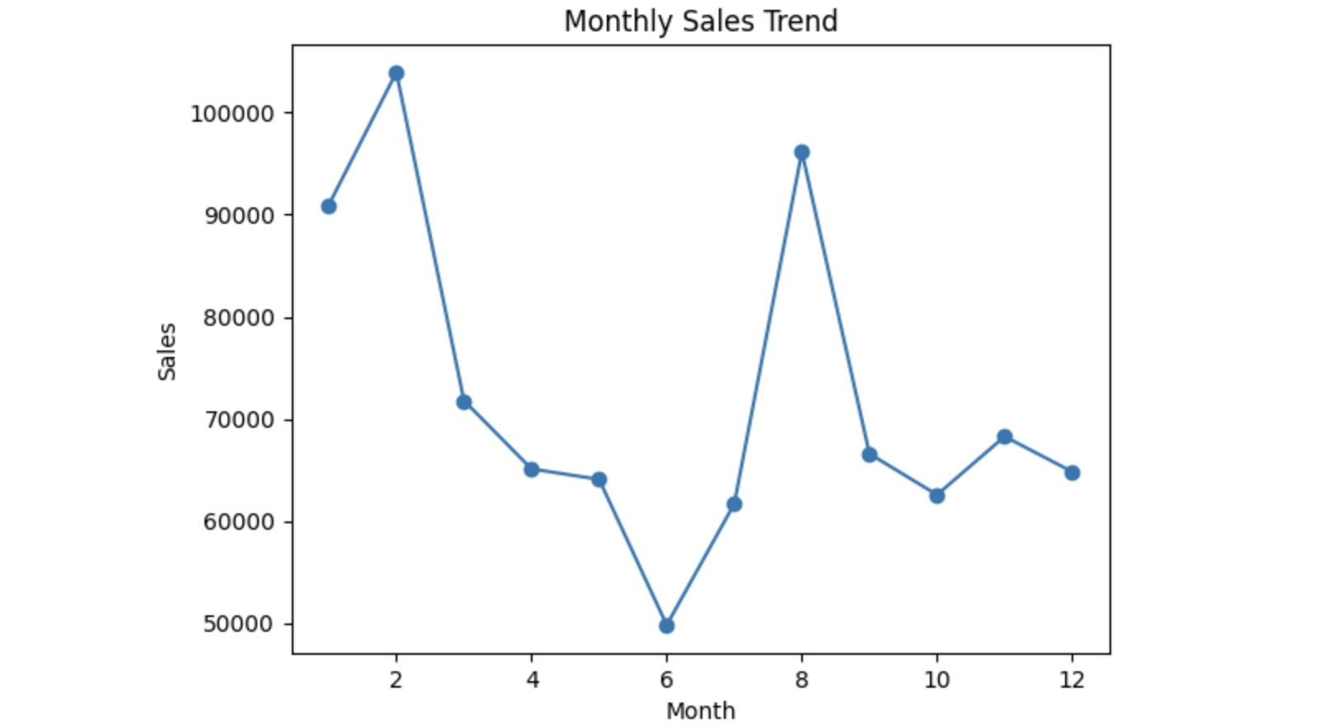
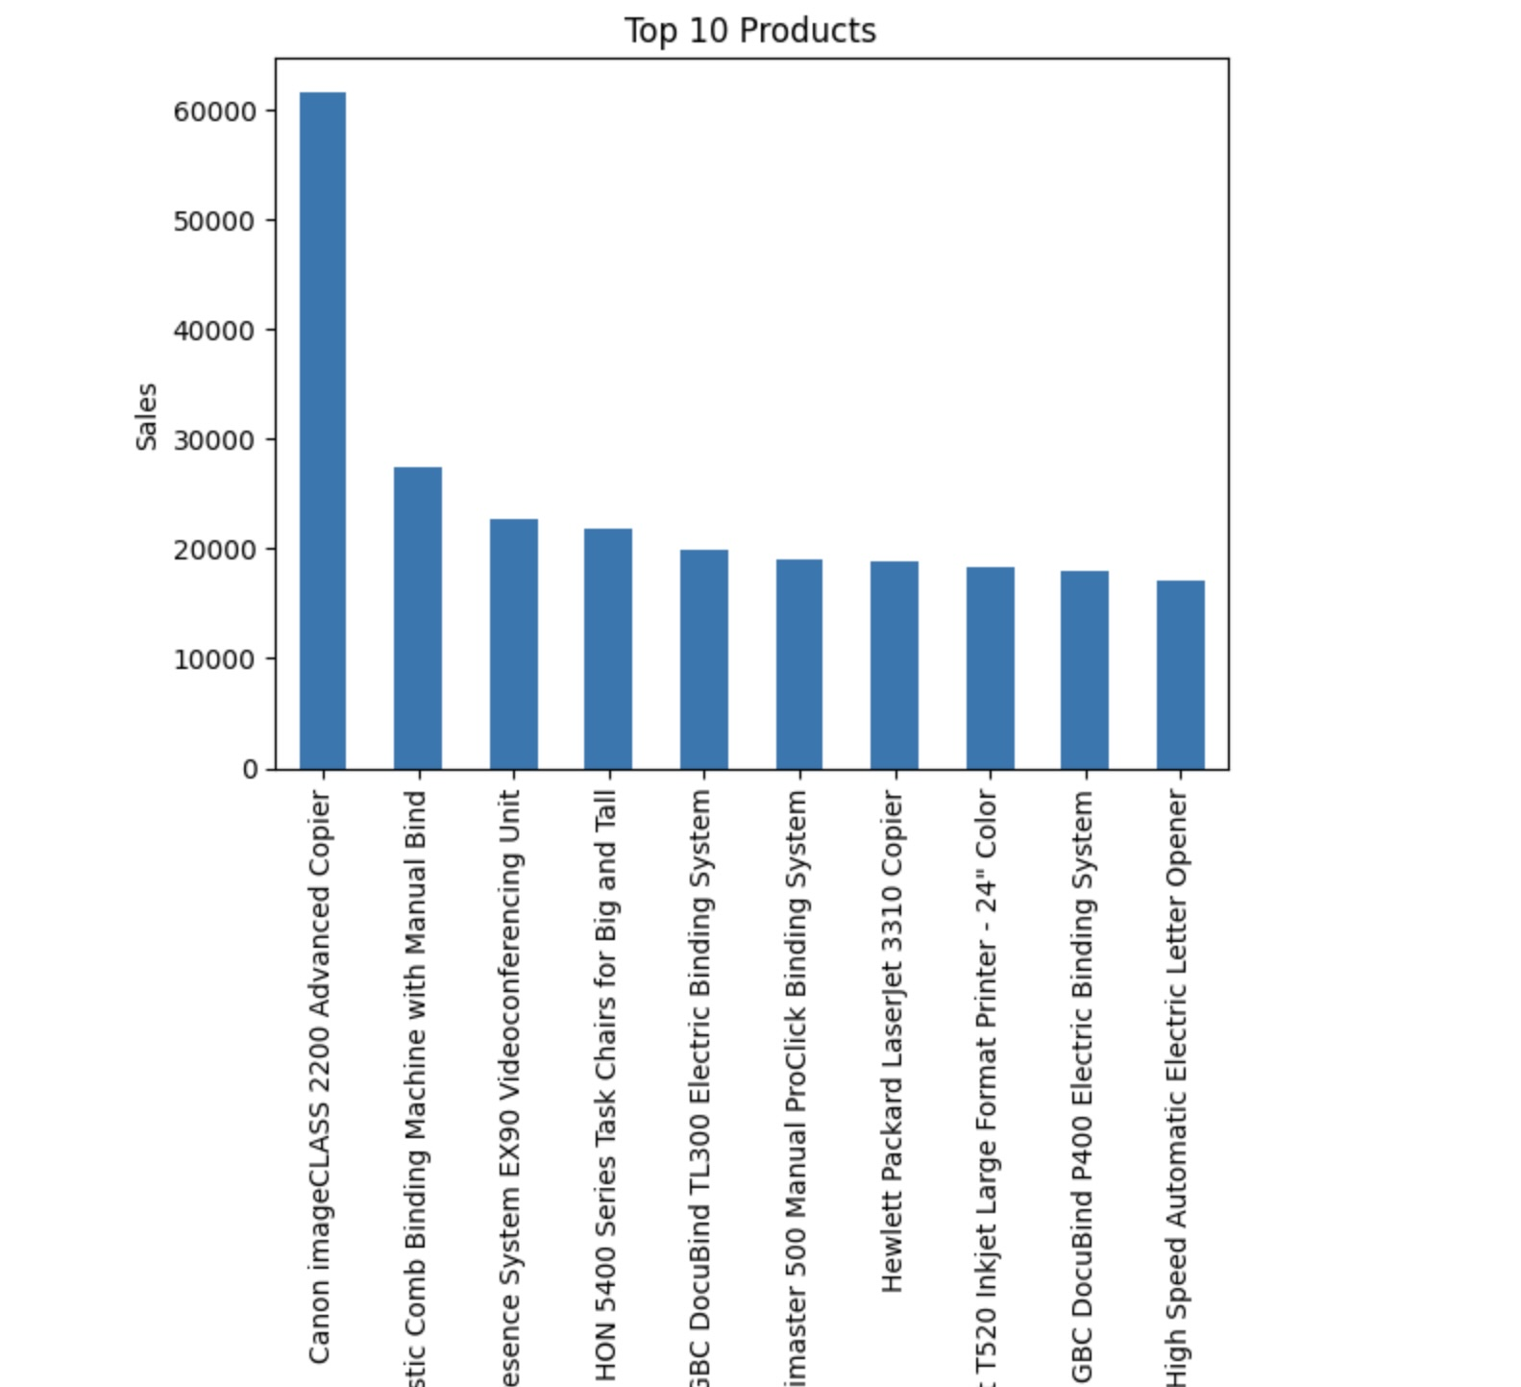
SLIDE 12 Business Sales Performance Analytics

Slide 13
THANK YOU

